Slide 1
A MAF OPEN-DEFENCE ON TOXICITY EFFECTS OF Erythrophleum suaveolens EXTRACTS ON SUB-ADULT Clarias gariepinus (Burchell, 1822)
BY
EGUNJOBI, OLAMILEKAN JOHNSON
PG14/0119
(B.AQFM, Abeokuta)
DEPARTMENT OF AQUACULTURE AND FISHERIES MANAGEMENT
COLLEGE OF ENVIRONMENTAL RESOURCES MANAGEMENT
FEDERAL UNIVERSITY OF AGRICULTURE, ABEOKUTA

Slide 2
INTRODUCTION
Some plants have been reported for capturing fish, controlling predators and reduction of over population in aquaculture ponds over the world (Tiwari and Singh, 2003; Agbon et al., 2004, Fafioye, 2005).
According to Jett (1991), poisonous plants are found to be effective if applied generally rather than being applied against an individual target.
Plants are known to have virtually inexhaustible source of structurally diverse and biological active substances that account for vastly all the classes of fish poisons ever known to Man (Batabyal et al., 2007).
In other to increase the catch in traditional fishing, diverse fish poisons of plant origin have been used to either harm, stupefy or kill fish have been reported (Reed et al., 1967; Geidam et al., 2007).

Slide 3
INTRODUCTION CONT’D
The genus Erythrophleum is an endemic species in tropical Africa commonly used as poison (Dongmo et al., 2001).
Erythrophleum suaveolens is a poisonous plant that belongs to the Fabaceae family (Burkill, 1985).
It is a perennial tree of about 30m in height, often low-branching and producing a dense spreading crown (Burkill, 1985).
It is traditionally called Obo and Erun (Yoruba) Inyi (Igbo) Baska (Hausa) Aba (Akan-Asante, Ghana) Tali (koranko, Sierra leone)
Studies have shown that the plant Erythrophleum species is extremely toxic to livestock especially sheep and cow (Aiyegoro et al., 2007).

Slide 4
JUSTIFICATION
The use of ichthyotoxic plants has been widely embraced in preference to synthetic compounds because they do not bio-accumulate in aquatic ecosystem, hence environmentally friendly (Agbon et al., 2002; Omoniyi et al., 2002; Fafioye 2005).
Neuwinger (2004) also observed that there is a wide variety ofn wild and cultivated poisonous plants available to coastal fishermen for capturing fish.
Siegler (2002) emphasized that these active compounds lead to growing conccerns on their potential to cause adverse effects on the health of aquatic organisms especially non target species.
Erythrophleum suaveolens is used as poison or repellant against rodents, insects and some aquatic animals and also in tanning hides and as dye (Aiyegoro et al., 2007).
Most research studies carried out on E. suaveolens have been centered on terrestrial animals with little or no study on the toxicity of its diffferent parts on aquatic organisms especially fish

Slide 5
OBJECTIVES OF THE STUDY
MAIN OBJECTIVE
The main objective of this research was to investigate the toxicity of the extracts of Erythrophleum suaveolens on sub-adult Clarias gariepinus.
The specific objectives were to
determine the acute lethal effects of extracts from the bark and leaves of E. suaveolens on C. gariepinus.
determine the sub-lethal effects of extracts from the bark and leaves of E. suaveolens on C. gariepinus.
evaluate and assess the weekly effect of extracts of E. suaveolens on haematological parameters of C. gariepinus
evaluate the possible effect of the plant extract on weight changes of the fish during exposure period
examine the histo-pathological effects on some organs (gills and liver) of C. gariepinus exposed to extracts from the bark and leaves of E. suaveolens.

Slide 6
MATERIALS AND METHODS
Experimental site
The experiment was carried out at the Hatchery section of Department of Aquaculture and Fisheries Management fish farm, Federal University of Agriculture, Abeokuta.
Sourcing of Plant materials
Freshly picked stem bark and leaf of Erythrophleum suaveolens was sourced from Ilewo-Orile, a town in Abeokuta North Local Government. The plant collected was identified at the Department of Forestry and Wildlife Management of the Federal University of Agriculture, Abeokuta.
Phytochemical screening
Phytochemical screening for major constituents was carried out on Erythrophleum suaveolens using standard qualitative methods as described by (Harborne, 1992).
Quantitative screening of phytochemicals
Chemical tests were carried out on the extracts to quantify total phenol, tannins, alkaloids, saponins, flavanoids constituents by using standard methods described by Jayaraman (1981).

Slide 7
MATERIALS AND METHODS CONT’D
Collection of sub-adult Clarias gariepinus
Three hundred (300) sub-adults, C. gariepinus with mean weight of 121.95 ± 0.31g and standard length of 24.47 ± 0.89 cm were collected from the Directorate of University farms (DUFARMS), Federal University of Agriculture, Abeokuta and transported in batches in a 50- litre capacity plastic container to the University hatchery.
Acclamatization of sub-adult Clarias gariepinus
Sub-adults C. gariepinus were first acclimatized in an outdoor concrete tank for two (2) weeks before they were transferred into a circular fibre tank inside the hatchery for one (1) week and were fed with 4mm commercial feed (Skretting) during the period. Water was changed every other day following the method recommended by Agbon et al. (2002).

Slide 8
MATERIALS AND METHODS CONT’D
PREPARATION OF Erythrophleum suaveolens EXTRACTS
The stem bark and leaf were first air dried for three (3) days at room temperature. The stem bark and leaf was oven dried for 24 hours using GallenKamp oven at 60ºC (Oshimagye et al., 2014).
After drying, the stem bark was pounded using mortar and pestle into finely grounded particles while, the leaf was pulverized with an electric blender (Paulson) and were kept in black polythene bags until required for use (Oshimagye et al., 2014).
960g of stem bark powder was soaked in 8 litres of water for 24hours and the broth was then sieved using a muslin cloth and the solution was applied immediately.
Serial dilutions were made from the stock solution at the following concentrations: 3.00 g/L, 2.25 g/L, 1.50 g/L and 0.75 g/L
1.12kg of leaf powder was soaked in 8 litres of water for 24hours the broth was sieved using a muslin cloth and the solution was applied immediately.
Dilutions were made from the stock solution at the following concentrations 3.50 g/L, 2.63 g/L, 1.75 g/L and 0.88 g/L

Slide 9
MATERIALS AND METHODS CONT’D
EXPERIMENTAL DESIGN
A completely randomized design was used for the experiment.
96-hr static non-renewal bioassay test procedure was used to determine the acute toxicity of E. suaveolens a aqueous stem bark and leaf extracts on sub-adult C. gariepinus (APHA, 1992).
Seven (7) sub-adults were put in 60- litre rectangular plastic tanks with the water filled to a 40-litre mark
Five treatments and three replicates were used
Feeding was discontinued 48hrs prior to acute toxicity test.
Water quality parameters were determined using portable hand-held test kits

Slide 10
MATERIALS AND METHODS CONT’D
Sub-Lethal Test
From the LC₅₀ of the 96hr acute toxicity test, 1/10th of the value was used for the experiment
The fish were fed ad-libtum with 4mm commercial (Skeltering) fed twice daily for 28days
The aqueous stem bark and leaf extracts and water were renewed every other day (2days) for 28 days (Agbon et al., 2002).
There were three treatments and three replicates

Slide 11
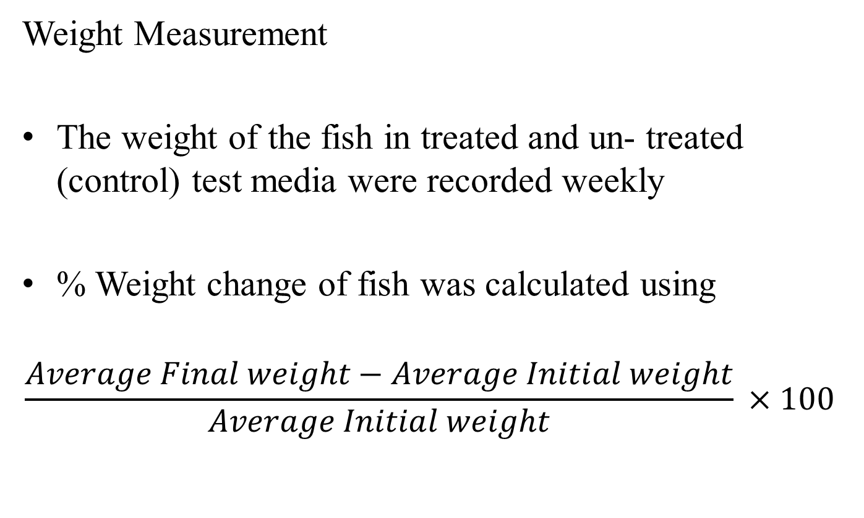
MATERIALS AND METHODS CONT’D
Weight Measurement
The weight of the fish in treated and un- treated (control) test media were recorded weekly
% Weight change of fish was calculated using
$$\frac{Average Final weight−Average Initial weight}{Average Initial weight} ×100$$

Slide 12
MATERIALS AND METHODS CONT’D
Haematological Tests
Blood was collected from the ventral region using hypodermic needle and syringe, and put into EDTA vials and taken to laboratory for analysis using methods described by Masson et al. (2002)
Blood samples were estimated for PCV, RBC, WBC, Hb, white blood cell differential and red blood cell differentials
Histological Tests
Histological analysis of experimental fish was carried out using Heamatoxylin and Eosin techniques

Slide 13
DATA ANALYSIS
Data from acute toxicity was analysed using percentage mortalities and transformed into their respective probits (Finney, 1952).
Data from Sub-lethal test, water parameters, haematological parameters and weight measurement were subjected to analysis of variance (ANOVA) and means separated using Duncan Multiple Range Test (DMRT).

Slide 14
RESULTS
AND
DISCUSSION

Slide 15
PHYTOCHEMICAL SCREENING
Table 1: Qualitative phytochemical screening of Erythrophleum suaveolens plant
Parameters | Stem bark | Leaf
Phenols | + | ++
Flavonoids | + | +
Alkaloids | ++ | ++
Oxalates | + | +
Tannins | ++ | ++
Saponins | + | ++
Steroids | - | +
Cyanogenic glycosides | + | +
(-): Absent; (+): Present

Slide 16
Table 2: Phytochemical screening of Erythrophleum suaveolens plant showing the quantity of the various phenolic compounds present
Parameters | Stem bark | Leaf
Tanins(%) | 5.00 | 4.60
Saponins (%) | 4.00 | 3.00
Flavanoids (%) | 0.10 | 0.20
Alkaloids (%) | 0.50 | 1.00
Oxalate (%) | 0.03 | 0.02
Steroids(%) | 0.01 | 0.01
Cyanogenic glycosides(%) | 0.02 | 0.03
Phenols (%) | 0.05 | 0.32

Slide 17
Table 3: Behavioural changes of sub adult Clarias gariepinus in aqueous stem bark extract of Erythrophleum suaveolens during 96-hour exposure at different concentrations
Behaviours | Concentration (g/L)
 | 0.00 | 0.75 | 1.50 | 2.25 | 3.00
Air gulping | - | - | + | ++ | +++
Barbel deformation | - | - | - | - | -
Discolouration | - | - | + | ++ | ++
Erractic swimming | - | - | + | ++ | +++
Scratching on plastic tank | - | - | - | +++ | +++
Jumping | - | - | + | ++ | ++
Resting at bottom | - | + | ++ | ++ | +++
Hanging vertically in water column | - | + | ++ | ++ | ++
Fin deformation | - | - | + | ++ | ++
(-) Absent; (+) Present

Slide 18
Table 4: Behavioural changes of sub-adult Clarias gariepinus in aqueous leaf extract of Erythrophleum suaveolens during 96-hour exposure at different concentrations
Behaviours | Concentration (g/L)
 | 0.00 | 0.88 | 1.75 | 2.63 | 3.50
Air gulping | - | - | + | ++ | +++
Barbel deformation | - | - | + | ++ | ++
Discolouration | - | - | + | ++ | ++
Erractic swimming | - | - | + | ++ | +++
Scratching on plastic tank | - | - | + | +++ | +++
Jumping | - | - | ++ | ++ | ++
Resting at bottom | - | + | ++ | ++ | +++
Hanging vertically in water column | - | + | ++ | ++ | ++
Fin deformation | - | - | - | ++ | ++
(-) Absent; (+) Present

Slide 19
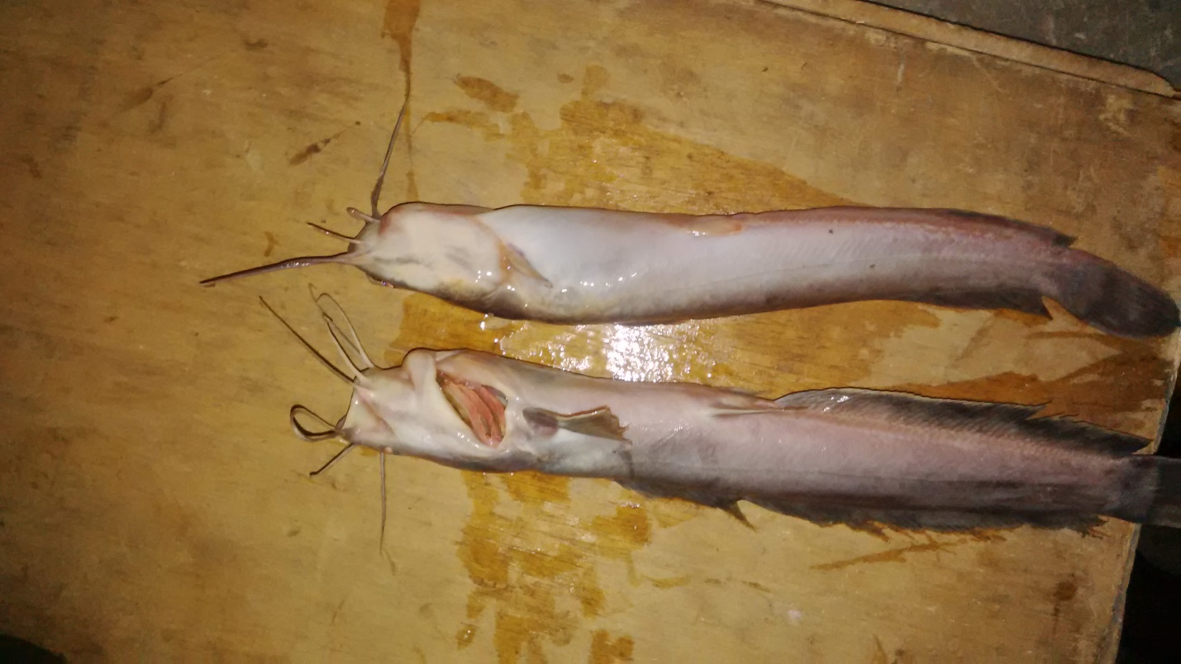
Plate 1: Sub-adult Clarias gariepinus showing physiological responseto stem bark and leaf aqueous extract of Erythrophleum suaveolens at death

Slide 20
Table 5: Water quality parameters during 96-hr exposure of sub-adult Clarias gariepinus to Erythrophleum suaveolensaqueous stem bark and leaf extracts
Conc. (g/L) | DO (mg/L) | pH | TEMP (ºC) | EC (µS/cm) | TDS (mg/L)
Control | 3.93 ± 0.17ª | 7.38 ± 0.06^{ab} | 27.03 ± 0.57ª | 527.50 ± 38.40^{c} | 264.00 ± 18.99ª
0.75s | 2.80 ± 0.28^{b} | 7.32 ± 0.03^{ab} | 27.10 ± 0.56ª | 568.75 ± 51.59^{c} | 284.75 ± 24.63ª
1.50 s | 1.05 ± 0.36^{c} | 7.38 ± 0.05^{ab} | 26.93 ± 0.66ª | 669.25 ± 74.64^{abc} | 335.25 ± 37.41^{abc}
2.25s | 1.43 ± 0.15^{c} | 7.35 ± 0.05^{ab} | 27.05 ± 0.61ª | 706.00 ± 84.89^{abc} | 352.25 ± 40.38^{abc}
3.00 s | 1.35 ± 0.41^{c} | 7.45 ± 0.10ª | 26.95 ± 0.57ª | 901.50 ± 102.10ª | 443.00 ± 48.53ª
0.88 l | 3.11 ± 0.53^{ab} | 7.43 ± 0.05ª | 27.00 ± 0.56ª | 545.50 ± 41.21^{c} | 273.00 ± 20.15ª
1.75l | 1.60 ± 0.18^{c} | 7.32 ± 0.03^{ab} | 27.23 ± 0.56ª | 750.50 ± 104.78^{abc} | 372.25 ± 50.56^{abc}
2.63 l | 1.06 ± 0.35^{c} | 7.30 ± 0.04^{ab} | 26.98 ± 0.59ª | 601.00 ± 44.83^{bc} | 301.00 ± 21.89^{bc}
3.50 l | 1.53 ± 0.17^{c} | 7.20 ± 0.07^{b} | 27.20 ± 0.57ª | 816.00 ± 91.71^{ab} | 412.00 ± 50.27^{ab}
*Means with the same superscripts in the same column are not significantly (p>0.05) different
*DO: Dissolved oxygen; pH: Hydrogen Ion concentration; Temp: Temperature; EC: Electrical conductivity; TDS: Total dissolved solids
**s: Stem-bark; l: Leave

Slide 21
Table 6: Mortality of sub- adult Clarias gariepinus exposed to Erythrophleum suaveolens stem bark aqueous extract over the 96-hr period
Concentration (g/L) | Mortality (%) | Log₁₀ Dose (Concentration) | Probits
3.00 | 78.50 | 0.4771 | 5.81
2.25 | 42.85 | 0.3522 | 4.82
1.50 | 14.28 | 0.1761 | 3.92
0.75 | 0.00 | -0.1249 | 0
Control | 0.00 | 0 | 0

Slide 22
Figure 1: 96-hr LC₅₀ of aqueous stem bark extract of Erythrophleum suaveolens on
sub-adult Clarias gariepinus
LC₅₀ = 2.30 g/L

Slide 23
Table 7: Mortality of sub-adult Clarias gariepinus exposed Erythrophleum suaveolens l aqueous leaf extract over the 96-hr period
Concentration (g/L) | Mortality (%) | Log₁₀ Dose (Concentration) | Probits
3.50 | 78.50% | 0.5441 | 5.81
2.63 | 42.85% | 0.4191 | 4.82
1.75 | 42.85% | 0.243 | 4.82
0.88 | 0.00% | -0.058 | 0
Control | 0.00 | 0 | 0

Slide 24
Figure 2: 96-hr LC₅₀ of aqueous leaf extract of Erythrophleum suaveolens on sub-adult Clarias gariepinus
LC₅₀ = 2.56 g/L

Slide 25
Table 8: Haematological parameters of sub-adult Clarias gariepinus exposed to Erythrophleum suaveolens aqueous stem bark and leaf extracts
Parameters
PCV (%) | 18.43 ± 0.94
Hb (g/dl) | 6.22 ± 0.32
RBC (x10¹²/L) | 0.81 ± 0.04
WBC (x10³/L) | 9.64 ± 0.52
MCV (fL) | 227.60 ± 2.11
MCH (pg) | 76.93 ± 0.91
MCHC (g/dl) | 33.80 ± 0.33
HET (%) | 41.00 ± 2.25
LYM (%) | 54.57 ± 2.14
MON (%) | 0.43 ± 0.20
EOS (%) | 4.00 ± 0.31
BAS (%) | 0.00
*PCV: Park cell volume; Hb: Haemoglobin count; RBC: Red blood cell count; WBC: White blood cell count; MCV: Mean corpuscular volume; MCH: Mean corpuscular haemoglobin; MCHC: Mean corpuscular haemoglobin concentration; HET: Heterophils; LYM: Lymphocytes; MON: Monocytes; EOS: Eosinophils; BAS: Basophils

Slide 26
Table 9: Mean values of haematological parameters of sub-adult Clarias gariepinus exposed to sub-lethalconcentration (LC₅₀) of Erythrophleum suaveolens aqueous stem bark and leaf extracts at 7th day
Parameters | Control (0.00 g/L) | Stem bark extract (0.23 g/L) | Leaf extract (0.26 g/L)
PCV (%) | 15.67 ± 1.20^{b} | 25.00 ± 2.52^{ab} | 28.67 ± 4.67ª
Hb (g/dl) | 5.33 ± 0.39^{b} | 8.40 ± 0.85^{ab} | 9.53 ± 1.56ª
RBC (x10¹²/L) | 0.71 ± 0.06^{b} | 1.10 ± 0.11^{ab} | 1.27 ± 0.22ª
WBC (x10³/L) | 11.70 ± 1.29 | 10.67 ± 1.13 | 10.60 ± 0.30
MCV (fL) | 221.87 ± 1.27 | 228.14 ± 2.54 | 226.58 ± 2.87
MCH (pg) | 75.57 ± 0.59 | 76.63 ± 0.30 | 75.35 ± 0.85
MCHC (g/dl) | 34.06 ± 0.12 | 33.60 ± 0.25 | 33.26 ± 0.30
HET (%) | 38.67 ± 3.71 | 38.33 ± 3.28 | 39.67 ± 0.88
LYM (%) | 57.00 ± 3.51 | 57.00 ± 3.05 | 56.00 ± 0.58
MON (%) | 0.67 ± 0.33 | 0.67 ± 0.33 | 0.67 ± 0.33
EOS (%) | 3.67 ± 0.67 | 4.00 ± 0.58 | 4.67 ± 0.33
BAS (%) | 0.00 | 0.00 | 0.00
*Means with different superscripts along same row show significant (p<0.05) difference
**PCV: Park cell volume; Hb: Haemoglobin count; RBC: Red blood cell count; WBC: White blood cell count; MCV: Mean corpuscular volume; MCH: Mean corpuscular haemoglobin; MCHC: Mean corpuscular haemoglobin concentration; HET: Heterophils; LYM: Lymphocytes; MON: Monocytes; EOS: Eosinophils; BAS: Basophils

Slide 27
Table 10: Haematological parameters of sub-adult Clarias gariepinus exposed to sub-lethal concentration (LC₅₀) of Erythrophleum suaveolens aqueous stem bark and leaf extracts at 14th day
Parameters | Control (0.00 g/L) | Stem bark extract (0.23 g/L) | Leaf extract (0.26 g/L)
PCV (%) | 17.33 ± 1.76^{b} | 29.33 ± 1.33ª | 33.33 ± 1.76ª
Hb (g/dl) | 5.97 ± 0.64^{b} | 9.77 ± 0.47ª | 11.03 ± 0.67ª
RBC (x10¹²/L) | 0.77 ± 0.07^{b} | 1.27 ± 0.06ª | 1.49 ± 0.09ª
WBC (x10³/L) | 11.67 ± 1.29ª | 8.77 ± 0.27^{b} | 10.23 ± 0.07^{ab}
MCV (fL) | 223.87 ± 3.11 | 230.46 ± 0.94 | 224.03 ± 2.52
MCH (pg) | 77.01 ± 1.80 | 76.72 ± 0.14 | 74.08 ± 0.47
MCHC (g/dl) | 30.83 ± 1.69ª | 34.55 ± 7.30^{b} | 32.40 ± 2.41^{b}
HET (%) | 37.33 ± 2.40 | 40.00 ± 3.00 | 38.33 ± 1.45
LYM (%) | 58.00 ± 2.52 | 55.67 ± 2.67 | 57.67 ± 1.20
MON (%) | 0.33 ± 0.33 | 1.00 ± 0.00 | 1.00 ± 0.00
EOS (%) | 4.33 ± 0.67 | 3.33 ± 0.33 | 4.00 ± 0.58
BAS (%) | 0.00 | 0.00 | 0.00
*Means with different superscripts along same row show significant (p<0.05) difference
**PCV: Park cell volume; Hb: Haemoglobin count; RBC: Red blood cell count; WBC: White blood cell count; MCV: Mean corpuscular volume; MCH: Mean corpuscular haemoglobin; MCHC: Mean corpuscular haemoglobin concentration; HET: Heterophils; LYM: Lymphocytes; MON: Monocytes; EOS: Eosinophils; BAS: Basophils

Slide 28
Table 11: Mean values of haematological parameters of sub-adult Clarias gariepinus exposed to sub-lethal concentrations (LC₅₀) of Erythrophleum suaveolens aqueous stem bark and leaf extracts at 21st day
Parameters | Control (0.00 g/L) | Stem bark extract (0.23 g/L) | Leaf extract (0.26 g/L)
PCV (%) | 21.00 ± 2.08^{b} | 33.33 ± 1.67ª | 32.33 ± 1.67ª
Hb (g/dl) | 7.10 ± 0.76^{b} | 11.20 ± 0.60ª | 11.10 ± 0.60ª
RBC (x10¹²/L) | 0.90 ± 0.06^{b} | 1.42 ± 0.08ª | 1.36 ± 0.07ª
WBC (x10³/L) | 10.73 ± 0.75 | 9.23 ± 0.97 | 8.03 ± 0.67
MCV (fL) | 231.44 ± 8.35 | 233.89 ± 2.10 | 237.10 ± 0.66
MCH (pg) | 78.18 ± 3.48 | 78.88 ± 0.70 | 81.37 ±0.77
MCHC (g/dl) | 33.76 ± 0.41 | 33.59 ± 0.13 | 34.32 ± 0.09
HET (%) | 34.00 ± 1.15^{b} | 37.67 ± 0.67ª | 33.00 ± 0.00^{b}
LYM (%) | 58.67 ± 1.86^{b} | 59.67 ± 0.33^{ab} | 63.33 ± 0.33ª
MON (%) | 0.00 | 0.67 ± 0.33 | 0.00
EOS (%) | 4.00 ± 0.58ª | 2.00 ± 0.00^{b} | 3.00 ± 0.00^{ab}
BAS (%) | 0.00 | 0.00 | 0.00
*Means with different superscripts along same row show significant (p<0.05) difference
**PCV: Park cell volume; Hb: Haemoglobin count; RBC: Red blood cell count; WBC: White blood cell count; MCV: Mean corpuscular volume; MCH: Mean corpuscular haemoglobin; MCHC: Mean corpuscular haemoglobin concentration; HET: Heterophils; LYM: Lymphocytes; MON: Monocytes; EOS: Eosinophils; BAS: Basophils

Slide 29
Table 12: Haematological parameters of sub-adult Clarias gariepinus exposed to sub-lethal concentrations (LC₅₀) of Erythrophleum suaveolens aqueous stem bark and leaf extracts at 28th day
Parameters | Control (0.00 g/L) | Stem bark extract (0.23 g/L) | Leaf extract (0.26 g/L)
PCV (%) | 23.67 ± 1.86 | 31.67 ± 5.67 | 36.00 ± 1.00
Hb (g/dl) | 7.97 ± 0.68 | 10.73 ± 1.93 | 11.67 ± 0.64
RBC (x10¹²/L) | 1.00 ± 0.06^{b} | 1.35 ± 0.21^{ab} | 1.51 ± 0.01ª
WBC (x10³/L) | 10.37 ± 1.04 | 8.73 ± 1.33 | 9.57 ± 0.27
MCV (fL) | 237.05 ± 5.86 | 233.49 ± 5.42 | 238.34 ± 5.01
MCH (pg) | 79.75 ± 2.95 | 79.11 ± 1.92 | 77.24 ± 1.90
MCHC (g/dl) | 33.62 ± 0.41ª | 33.88 ± 0.04ª | 32.40 ± 0.11^{b}
HET (%) | 34.67 ± 1.33 | 34.33 ± 1.33 | 35.33 ± 1.67
LYM (%) | 58.33 ± 1.67 | 61.33 ± 1.67 | 62.00 ± 1.00
MON (%) | 0.33 ± 0.33^{b} | 1.00 ± 0.00ª | 0.00^{b}
EOS (%) | 3.33 ± 0.33 | 3.33 ± 0.33 | 2.67 ± 0.67
BAS (%) | 0.00 | 0.00 | 0.00
*Means with different superscripts along same row show significant (p<0.05) difference
**PCV: Park cell volume; Hb: Haemoglobin count; RBC: Red blood cell count; WBC: White blood cell count; MCV: Mean corpuscular volume; MCH: Mean corpuscular haemoglobin; MCHC: Mean corpuscular haemoglobin concentration; HET: Heterophils; LYM: Lymphocytes; MON: Monocytes; EOS: Eosinophils; BAS: Basophils

Slide 30
Figure 3: Weekly weight gain (mean ± SEM) of sub-adult Clarias gariepinus exposed to sub-lethal concentration of aqueous stem bark and leaf extracts of Erythrophleum suaveolens

Slide 31
Table 13: Percentage weight gain of sub-adult Clarias gariepinus exposed to sub-lethal concentration (LC₅₀) of Erythrophleum suaveolens aqueous stem bark and leaf extracts for 28days
 | Initial weight (g) | Final weight (g) | Percentage weight gain (%)
Control (0.00 g/L) | 124.61 ± 0.75 | 155.27 ± 2.07 | 24.60 ± 1.26
Stem bark extract (0.23 g/L) | 124.82 ± 0.96 | 158.90 ± 2.78 | 27.32 ± 2.25
Leaf extract (0.26 g/L) | 124.81 ± 1.07 | 162.25 ± 8.96 | 30.00 ± 7.03

Slide 32
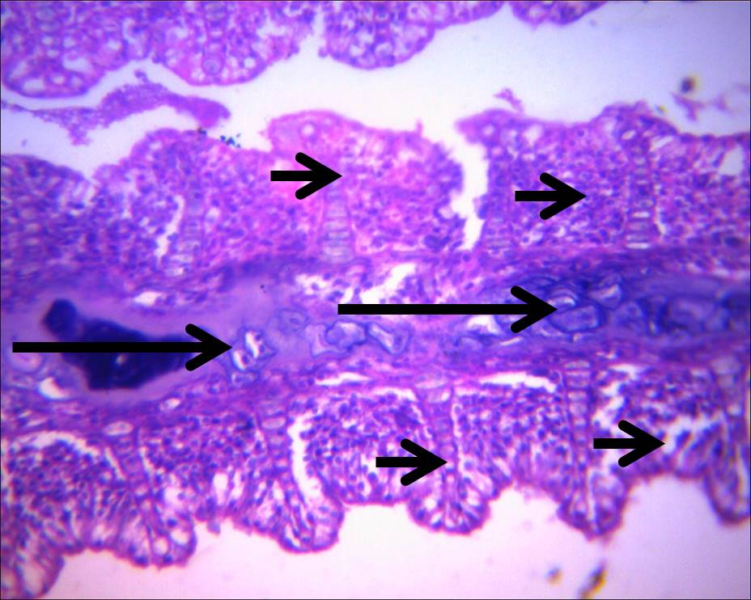
HISTOLOGICAL CHANGES IN THE GILLS
Plate 2: Section of gill showing normal cartilaginous core of the primary lamellae (long arrows) and the mucosa of the secondary lamellae (short arrows) of sub-adult Clarias gariepinus before exposure to aqueous stem bark and leaf extracts of Erythrophleum suaveolens (H & E; x400).

Slide 33
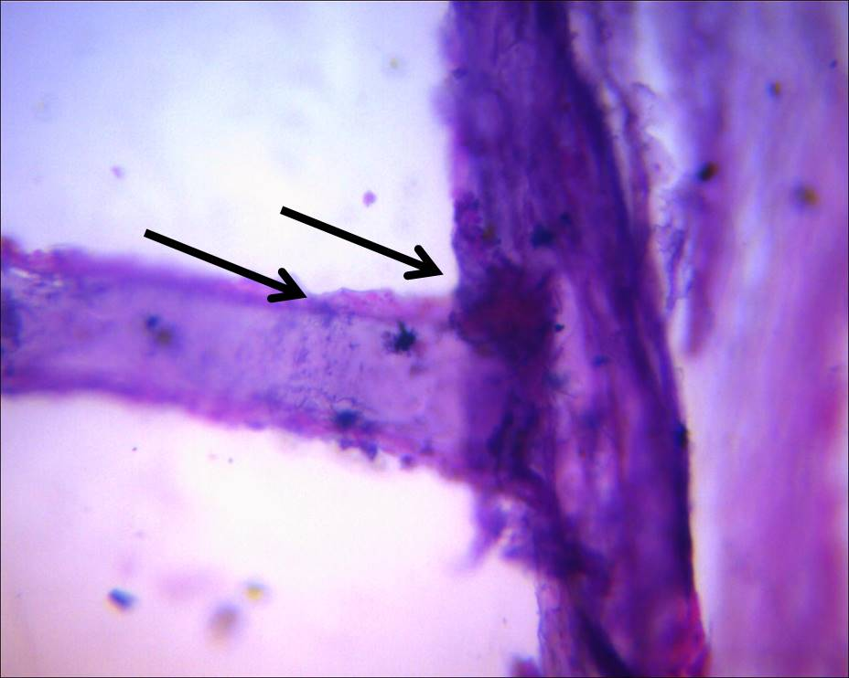
Plate 3: Section of the gill showing a very severe erosion of the entire gill mucosa (arrows) of sub-adult Clarias gariepinus exposed to sub-lethal (LC₅₀) concentration of aqueous stem bark extract of Erythrophleum suaveolens at 28th day. (H & E; x400)

Slide 34
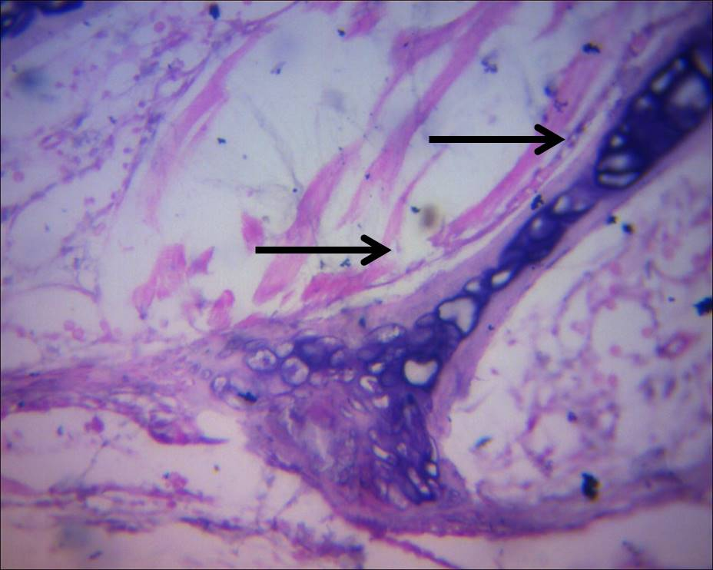
Plate 4: Section of the gill showing severely eroded mucosa of the secondary lamellae (arrows) of sub-adult Clarias gariepinus exposed to sub-lethal (LC₅₀) concentration of aqueous leaf extract of Erythrophleum suaveolens at 28th day. (H & E; x400)

Slide 35
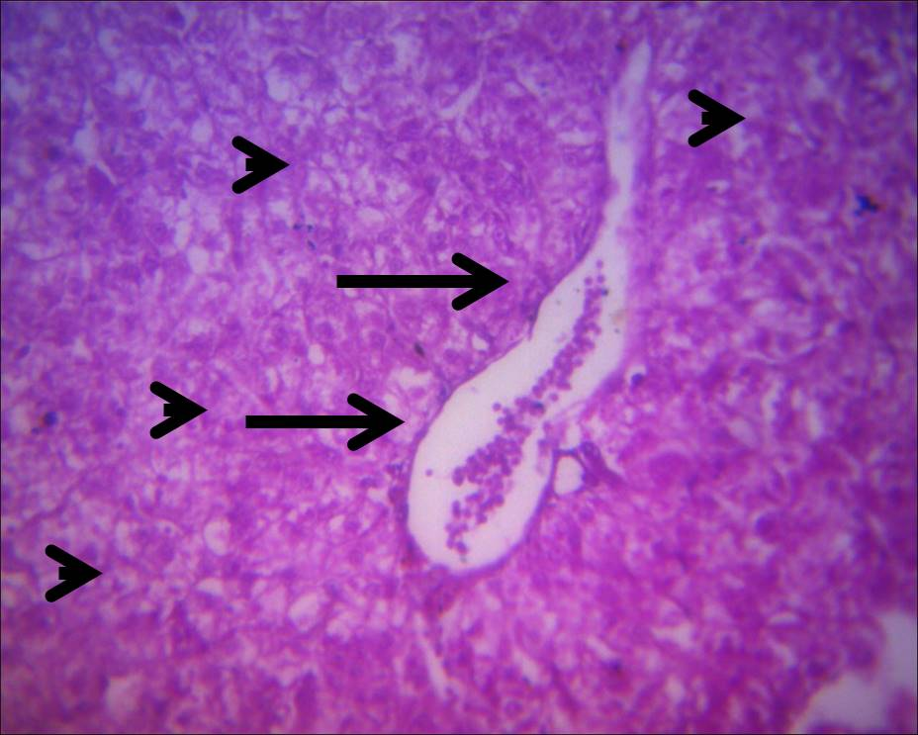
HISTOLOGY OF THE LIVER
Plate 5: Section of the liver showing normal hepatocytes (arrowheads) and a slightly congested portal vessels (long arrows) of Clarias gariepinus before exposure to aqueous stem bark and leaf extracts of Erythrophleum suaveolens (H & E; x400)

Slide 36
REFERENCES
Agbon, A.O., Omoniyi, I.T. and Teko, A.A. 2002. Acute toxicity of tobacco (Nicotiana tobaccum) leaf dust on Oreochromis niloticus and haematological changes resulting from sublethal exposure. Journal of Aquatic Sciences. 17, 1: 5-8
Aiyegoro, O. A., Akinpelu, D. A and Okoh, A. I. 2007. In vitro antibacterial potentials of the stem-bark of red water tree (Erythrophleum suaveolens). Journal of Biological Sciences. 7:1233-1237
APHA. 2005. Standard Methods for Examination of Water and Wastewater, American Public Health Association WWA, Washington, D.C.
Burkill, H. 1985. The useful plants of West Tropical Africa. 3(857):116-120. Centers for Disease Control and Prevention.Methicillin-resistant Staphylococcus aureus (MRSA) infections. Accessed April 17, 2012.
Caguan, A.G., Galaites, M.C. and Fajardo, L.J. 2004. Evaluation of botanical pisicides on Nile Tilapia Oreochromis niloticus L. and mosquitoe fish Gambusia affinis Baird and Girard. Proceedings on ISTA, 12-16 September. Manilla, Phillipines: 179-187pp.
Fafioye, O.O. 2005. Plants with piscicidal activities in Southwestern Nigeria. Turkish Journal of Fisheries and Aquatic Sciences. 5: 91-97
Finney, D. J., Ed. (1952): Probit Analysis.Cambridge, England, Cambridge University Press.
Omoniyi, I., Agbon, A.O. and Sodunke, S.A. 2002. Effect of lethal and sublethal concentrations of tobacco (Nicotiana tobaccum) leaf dust extract on weight and heamatological changes in Clarias gariepinus (Burchell). Journal of Applied Science and Environmental Management. 6, 2: 37-41

Slide 37
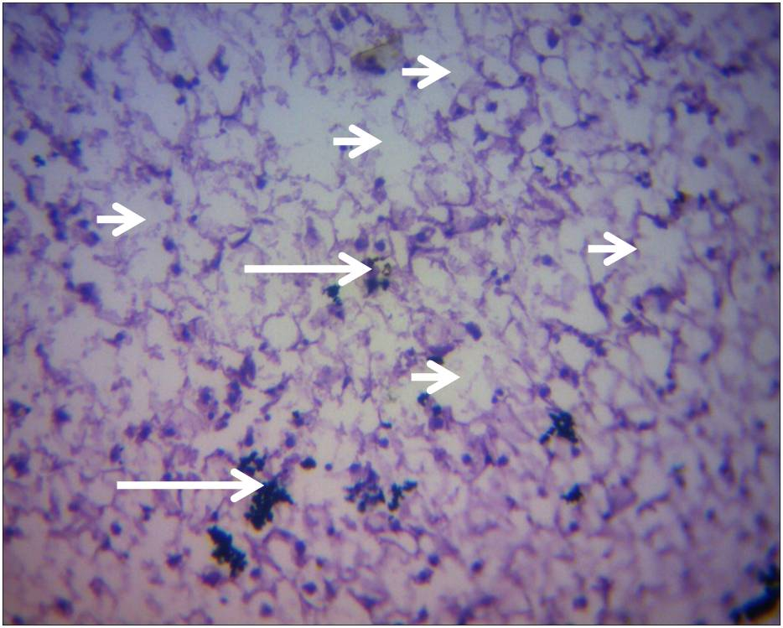
Plate 6: Section of the liver showing a severe diffuse vacuolation and necrosis of the (short arrows), with mild to moderate cellular infiltration(long arrows) of sub-adult Clarias gariepinus exposed to sub-lethal (LC₅₀) concentration of aqueous stem bark extract of Erythrophleum suaveolens at 28th day. (H & E; x400)

Slide 38
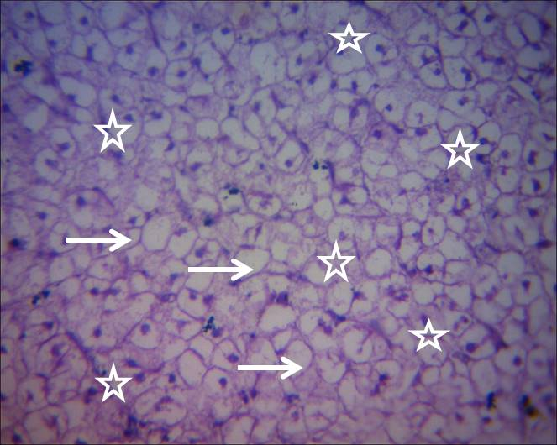
Plate 7: Section of the liver showing a severe diffuse vacuolation of hepatocytes (stars) with several hepatocytes necrotic (arrows) of Clarias gariepinus exposed to sub-lethal (LC₅₀) concentration of aqueous leaf extract of Erythrophleum suaveolens at 28th day (H & E; x400).

Slide 39
CONCLUSION
From this study:
Toxic substances such as tannins and oxalates were more in stem bark extract than in the leaf extract, while cyanogenic glycosides and phenols were more in leaf extract than the stem bark extract
The extract from the stem bark was more toxic (LC₅₀ = 2.30 g/L) than that of the leaf (LC₅₀ = 2.56 g/L)
Both the aqueous stem bark and leaf extracts reduced the dissolved oxygen (DO) in the water causing hypoxic condition and death of fish.
Exposure of C. gariepinus to both extracts caused increased production of PCV, Hb, and RBC which led to polycythemia in the fish
There was no significant (p>0.05) difference in the percentage weight gain of C. gariepinus exposed to the two extracts, however fish exposed to the leaf extracts show superior weight gain when compared to the stem bark and control fish.

Slide 40
RECOMMENDATIONS
Indiscriminate disposal of the plant stem bark and leaf should be discouraged; they are toxic and lethal at low concentrations.
Lower concentrations of both plant extracts could be useful for reducing or solving anemia problem in fish but further research should be carried out to determine appropiate concentration that will not have deleterious or damaging effects on fish.
Further studies should be carried out on the concentration of the leaf that could encourage growth. More so, the constituent of the leaf responsible for the growth should be established.
More studies should be carried out on the toxicity of other forms of extract on fish.

